Slide 1
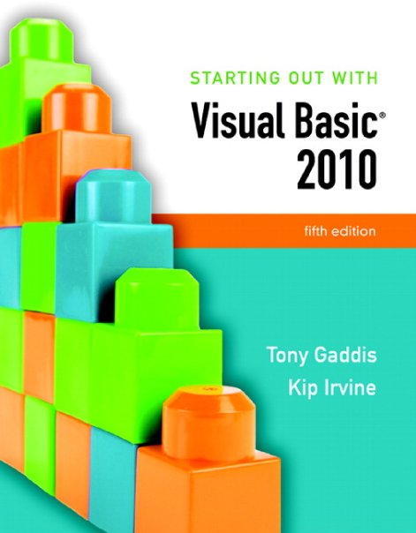

Slide 2
Chapter 1
Introduction to Programming and Visual Basic

Slide 3
Computer SYSTEMS: Hardware and Software
Section 1.1
Computer systems consist of similar hardware devices and hardware
components. This section provides an overview of computer
hardware and software organization.

Slide 4
Computer Hardware
Refers to the physical components
Not one device but a system of many devices
Major types of components include:
Central Processing Unit
Main memory
Secondary storage devices
Input devices
Output devices

Slide 5
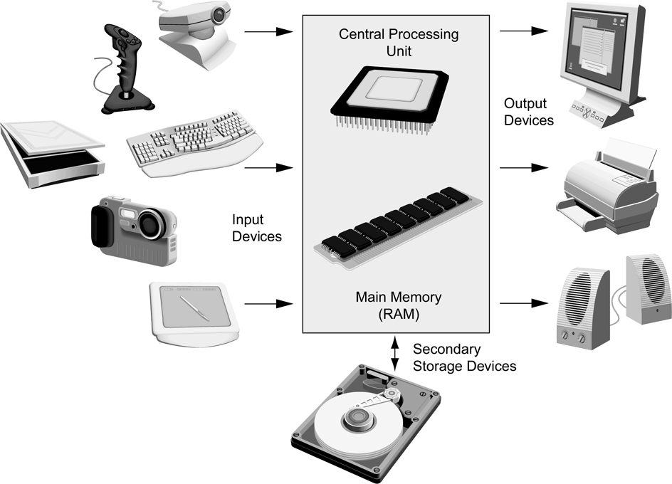
Organization of a Computer System

Slide 6
The CPU
Fetches instructions from main memory
Carries out the operations commanded by the instructions
Each instruction produces some outcome
CPU gets instructions from a program
A program is an entire sequence of instructions
Instructions are stored as binary numbers
Binary number - a sequence of 1’s and 0’s

Slide 7
Main Memory
Commonly known as random access memory, or just RAM
Holds instructions and data needed for programs that are currently running
RAM is usually a volatile type of memory
Contents are lost when power is turned off
Used as temporary storage

Slide 8
Secondary Storage
A nonvolatile storage medium
Contents retained while power is off
Hard disk drives are most common
Records data magnetically on a circular disk
Provides fast access to large amounts of data
Optical devices store data on CD’s as pits
USB flash memory devices
High capacity device plugs into USB port
Portable, reliable, and fits easily in a pocket

Slide 9
Input Devices
Any type of device that provides data to a computer from the outside world
For example:
Keyboard
Mouse
Scanner

Slide 10
Output Devices
Any type of device that provides data from a computer to the outside world
Examples of output data:
A printed report
An image such as a picture
A sound
Common output devices include:
Monitor (display screen)
Printer

Slide 11
Software
The programs that run on a computer
Two major categories
Operating systems
Controls the processes within the computer
Manages the computer's hardware devices
Application Software
Solve problems or perform tasks needed by users
Examples include word processing, spreadsheets, games, Internet browsers, playing music, etc)
Each program is referred to as an application
This book develops applications in Visual Basic

Slide 12
Programs and Programming Languages
Section 1.2
A program is a set of instructions a computer follows in order to
perform a task. A programming language is a special language used
to write computer programs.

Slide 13
What is a Program?
Computers can only follow instructions
A computer program is a set of instructions on how to solve a problem or perform a task
In order for a computer to compute someone’s gross pay, we must tell it to perform the steps on the following slide

Slide 14
Computing Gross Pay
Display message: "How many hours did you work?"
Allow user to enter number of hours worked
Store the number the user enters in memory
Display message: "How much are you paid per hour?"
Allow the user to enter an hourly pay rate
Store the number the user enters in memory
Multiply hours worked by pay rate and store the result in memory
Display a message with the result of the previous step
This well-defined, ordered set of steps for solving a problem is called an algorithm

Slide 15
States and Transitions
Memory snapshots show states of the program
Store hours worked in memory
Store hourly pay rate in memory
Multiply hours worked by pay rate and store amount earned in memory
Program Starting State
hours worked | ??
hourly pay rate | ??
amount earned | ??
Snapshot after Step 3
hours worked | 20
hourly pay rate | ??
amount earned | ??
Snapshot after Step 6
hours worked | 20
hourly pay rate | 25
amount earned | ??
Snapshot after Step 7
hours worked | 20
hourly pay rate | 25
amount earned | 500

Slide 16
Programming Languages
The steps in our algorithm must be stated in a form the computer understands
The CPU processes instructions as a series of 1’s and 0’s called machine language
This is a tedious and difficult format for people
Instead, programming languages allow us to use words instead of numbers
Software converts the programming language statements to machine language

Slide 17
Common Programming Languages
Visual Basic
Python
JavaScript
Java
C#
C
C++
PHP
Visual Basic (also called Visual Basic .NET) is now just a programming language *
Visual Studio is a separate programming environment with tools to:
Create screen elements
Write programming language statements

Slide 18
What is a Program Made Of?
Keywords (Reserved Words)
Words with special meaning that make up a high-level programming language, cannot be used for any other purpose
Operators
Special symbols that perform various operations on data
Variables
Used to store data in memory, named by the programmer
Syntax
Set of rules
Similar to the syntax (rules) of a spoken language, such as English, but must be strictly followed
If even a single syntax error appears in a program, it will not compile or execute

Slide 19
What is a Program Made Of?
Statements
Instructions made up of keywords, variables, and operators.
Procedures
Set of programming statements that perform a specific task
Comments (Remarks)
Ignored when the program runs, help human reader understand the purpose of programming statements
In Visual Basic, any statement that begins with an apostrophe (')

Slide 20
Methods of Programming
Procedural
Constructed as a set of procedures (operational, functional units)
Each procedure is a set of instructions
The Gross Pay computation is a procedure
Object-Oriented
Uses real-world objects such as students, transcripts, and courses
Objects have data elements called attributes
Objects also perform actions

Slide 21
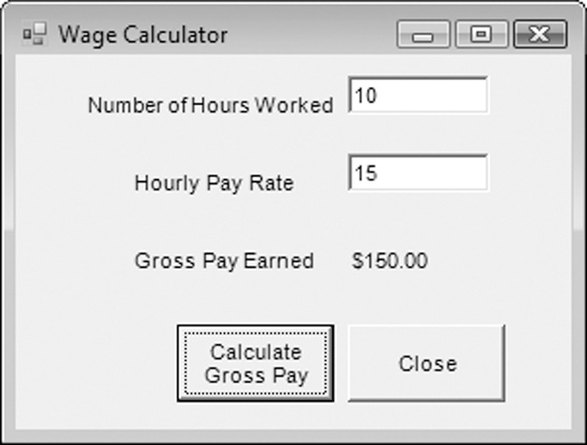
Example of an Object
This is a Visual Basic GUI object called a form
Contains data and actions
Data, such as Hourly Pay Rate, is a text property that determines the appearance of form objects
Actions, such as Calculate Gross Pay, is a method that determines how the form reacts
A form is an object that contains other objects such as buttons, text boxes, and labels

Slide 22
Example of an Object
Form elements are objects called controls
This form has:
Two TextBox controls
Four Label controls
Two Button controls
The value displayed by a control is held in the text property of the control
Left button text property is Calculate Gross Pay
Buttons have methods attached to click events

Slide 23
Event Driven Programming: Events
The GUI environment is event-driven
An event is an action that takes place within a program
Clicking a button (a Click event)
Keying in a TextBox (a TextChanged event)
Visual Basic controls are capable of detecting many, many events
A program can respond to an event if the programmer writes an event procedure

Slide 24
More about controls and programming
Section 1.3
As a Visual Basic programmer, you must design and create an
application’s GUI elements (forms and other controls) and the
programming statements that respond to and/or perform actions
(event handlers).

Slide 25
Visual Basic Controls
As a Windows user you’re already familiar with many Visual Basic controls:
Label - displays text the user cannot change
TextBox - allows the user to enter text
Button – performs an action when clicked
RadioButton - A round button that is selected or deselected with a mouse click
CheckBox – A box that is checked or unchecked with a mouse click
Form - A window that contains these controls
Tutorial 1-3 demonstrates these controls

Slide 26
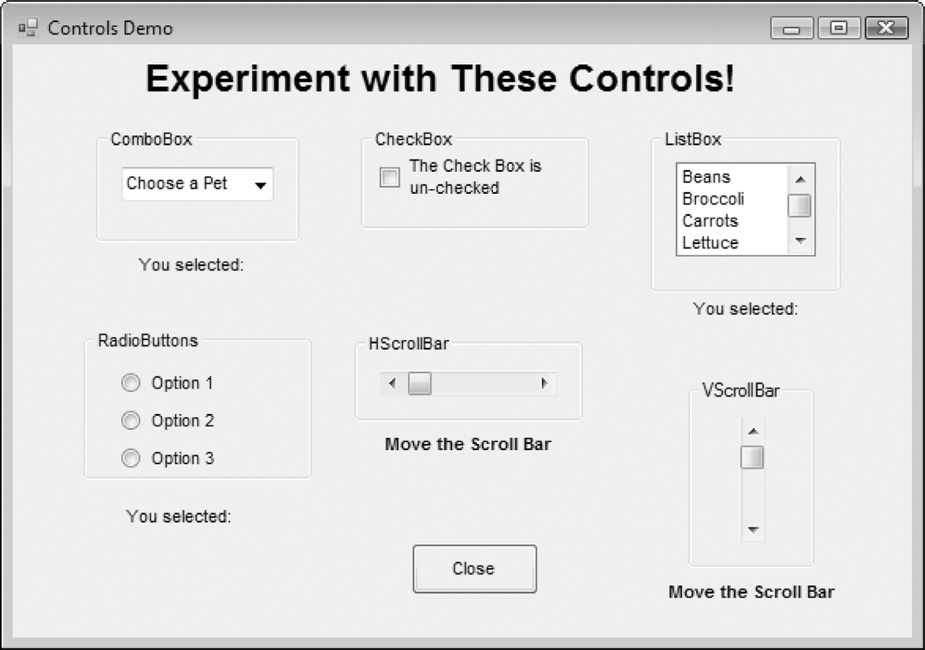
Tutorial 1-3, Visual Basic Controls

Slide 27
The Name Property
All controls have properties
Each property has a value (or values)
Not all properties deal with appearance
The name property establishes a means for the program to refer to that control
Controls are assigned relatively meaningless names when created
Programmers usually change these names to something more meaningful

Slide 28
Examples of Names
The Label controls use the default names (Label1, etc.)
Text boxes, buttons, and the Gross Pay label play an active role in the program and have been changed
Form1
Label1
txtHoursWorked
Label2
txtPayRate
Label3
lblGrossPay
btnCalcGrossPay
btnClose

Slide 29
Naming Conventions
Control names must start with a letter
Remaining characters may be letters, digits, or underscore
1st 3 lowercase letters indicate the type of control
txt… for Text Boxes
lbl… for Labels
btn… for Buttons
After that, capitalize the first letter of each word
txtHoursWorked is clearer than txthoursworked

Slide 30
The Programming Process
Section 1.4
The programming process consists of several steps, which include
designing, creating, testing, and debugging activities.

Slide 31
Step 1 of Developing an Application
Clearly define what the program is to do
For example, the Wage Calculator program:
Purpose: To calculate the user’s gross pay
Input: Number of hours worked, hourly pay rate
Process: Multiply number of hours worked by hourly pay rate (result is the user’s gross pay)
Output: Display a message indicating the user’s gross pay

Slide 32
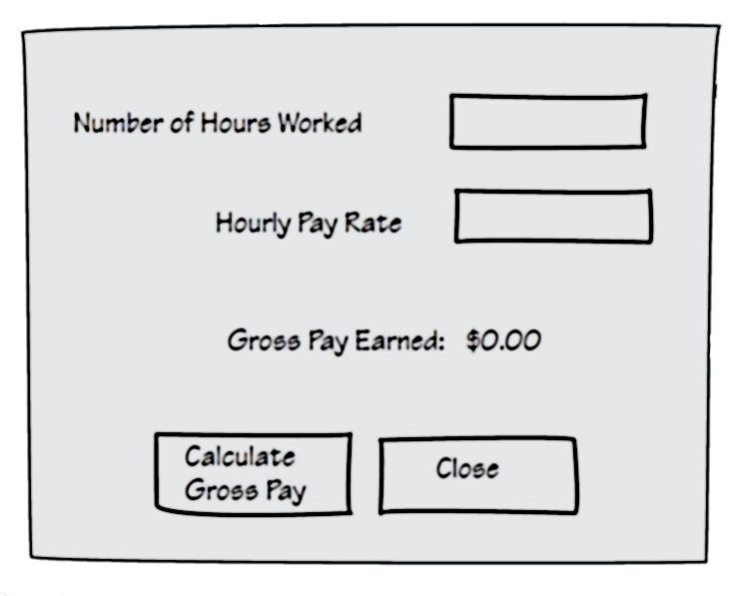
Step 2 of Developing an Application
Visualize the application running on the computer and design its user interface

Slide 33
Step 3 of Developing an Application
Determine the controls needed
Type Name Description
TextBox txtHoursWorked Allows the user to enter the number of hours worked.
TextBox txtPayRate Allows the user to enter the hourly pay rate
Label lblGrossPay Displays the gross pay, after the btnCalcGrossPay
button has been clicked
Button btnCalcGrossPay When clicked, multiplies the number of hours worked
by the hourly pay rate
Button btnClose When clicked, terminates the application
Label (default) Description for Number of Hours Worked TextBox
Label (default) Description for Hourly Pay Rate TextBox
Label (default) Description for Gross Pay Earned Label
Form (default) A form to hold these controls

Slide 34
Step 4 of Developing an Application
Define the values of each control’s relevant properties
Control Type Control Name Text
Form (Default) "Wage Calculator"
Label (Default) "Number of Hours Worked"
Label (Default) "Hourly Pay Rate"
Label (Default) "Gross Pay Earned"
Label lblGrossPay "$0.00"
TextBox txtHoursWorked ""
TextBox txtPayRate ""
Button btnCalcGrossPay "Calculate Gross Pay"
Button btnClose "Close"

Slide 35
Step 5 of Developing an Application
Determine the event handlers and other code needed for each control
Method Description
btnCalcGrossPay_Click Multiplies hours worked by hourly pay rate
These values are entered into the txtHoursWorked and txtPayRate TextBoxes
Result is stored in lblGrossPay Text property
btnClose_Click Terminates the application

Slide 36
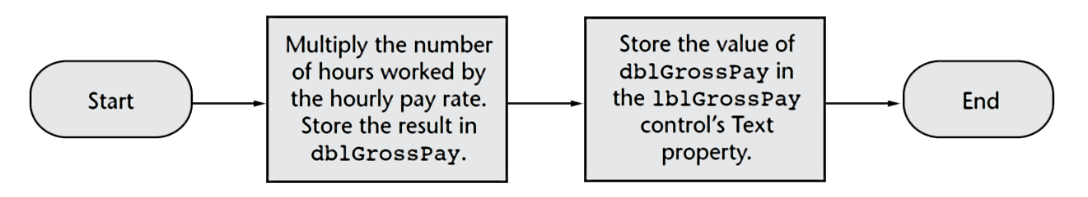
Step 6 of Developing an Application
Create a flowchart or pseudocode version of the code
A flowchart is a diagram that graphically depicts the flow of a method
Pseudocode is a cross between human language and a programming language

Slide 37
Step 7 of Developing an Application
Check the code for errors:
Read the flowchart and/or pseudocode
Step through each operation as though you are the computer
Use a piece of paper to jot down the values of variables and properties as they change
Verify that the expected results are achieved

Slide 38
Step 8 of Developing an Application
Use Visual Basic to create the forms and other controls identified in step 3
This is the first use of Visual Basic, all of the previous steps have just been on paper
In this step you develop the portion of the application the user will see

Slide 39
Step 9 of Developing an Application
Use the flowcharts or pseudocode from step 6 to write the actual code
This is the second step on the computer
In this step you develop the methods behind the click event for each button
Unlike the form developed on step 8, this portion of the application is invisible to the user

Slide 40
Step 10 of Developing an Application
Attempt to run the application - find syntax errors
Correct any syntax errors found
Syntax errors are the incorrect use of an element of the programming language
Repeat this step as many times as needed
All syntax errors must be removed before Visual Basic will create a program that actually runs

Slide 41
Step 11 of Developing an Application
Run the application using test data as input
Run the program with a variety of test data
Check the results to be sure that they are correct
Incorrect results are referred to as a runtime error
Correct any runtime errors found
Repeat this step as many times as necessary

Slide 42
Visual Studio and Visual Basic Express Edition (the Visual Basic Environment)
Section 1.5
Visual Studio and Visual Basic Express Edition consist of tools that
you use to build Visual Basic applications. The first step in using
Visual Basic is learning about these tools.

Slide 43
The Visual Studio IDE
Visual Studio is an integrated development environment, often abbreviated as IDE
Provides everything needed to create, test, and debug software including:
The Visual Basic language
Form design tools to create the user interface
Debugging tools to help find and correct programming errors
Visual Studio supports other languages beside Visual Basic such as C++ and C#

Slide 44
The Visual Basic Environment
Tutorial 1-4 introduces elements of the IDE:
Customizing the IDE
Design window – a place to design and create a form
Solution Explorer window – shows files in the solution
Properties window – modify properties of an object
Dynamic Help window – a handy reference tool
Toolbar – contains icons for frequently used functions
Toolbox window – objects used in form design
Tooltips – a short description of button’s purpose

